Slide 1
Firewalls

Slide 2
Outline
What are firewalls?
Types of Firewalls
Iptables firewall in Linux
Stateful Firewall
Application Firewall

Slide 3
Firewalls
It is a part in a computer system or in a network, designed to stop unauthorized traffic flowing from one network to another.
Separate trusted and untrusted components of a network.
Main functionalities are filtering data, redirecting traffic and protecting against network attacks.

Slide 4
Requirements of a firewall
In general, authorized traffic is defined by the security policy and is allowed to pass through the firewall.
The firewall itself must be immune to penetration.

Slide 5
Firewall Policy
User control: Control user’s access right to the data. This usually is applied to users inside the firewall perimeter.
Service control: Control the access to the service requested in the packet such as Telnet. Applied on the basis of ip address, protocol and port numbers in the packet.
Direction control: Determines the direction in which requests may be initiated and are allowed to flow through the firewall. It tells whether the traffic is “inbound” (From the network to firewall) or vice-versa “outbound”

Slide 6
Firewall actions
Accepted: Allowed to enter the connected network/host through the firewall.
Denied: Not permitted to enter the other side of firewall.
Rejected: Similar to “Denied”, but tells the source about this decision, through ICMP packet.

Slide 7
Types of filters
Depending on the mode of operation, there are three types of firewalls :
Packet Filter Firewall
Stateful Firewall
Application/Proxy Firewall

Slide 8
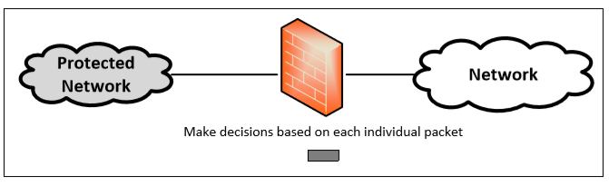
Packet Filter Firewall
Controls traffic based on the information in packet headers, without looking into the payload that contains application data.
Doesn’t care whether the packet is a part of existing stream or traffic.
Doesn’t maintain the states about packets. Also called Stateless Firewall.

Slide 9
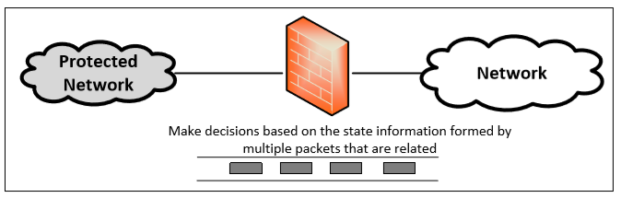
Stateful Firewall
If multiple packets are “related”, classify them as a class of the traffic. Filtering policy is defined for the traffic class.
Later, if a packet belongs to this class of traffic, then apply the class decision to the packet.

Slide 10
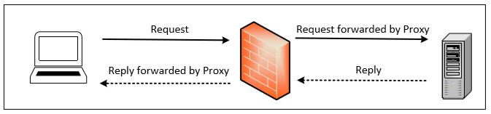
Application/Proxy Firewall
Controls input, output and access from/to an application or service.
Acts an intermediary by impersonating the intended recipient.
The client’s connection terminates at the proxy and a separate connection is initiated from the proxy to the destination host.
Data on the connection is analyzed up to the application layer to determine if the packet should be allowed or rejected.
Notes:
Limitation : Need to implement new proxies to handle new protocols. Slower compared to other firewalls
Advantage : Ability to authenticate users directly rather than depending on network addresses of the system. Reduces the risk of IP spoofing attacks that are easy to launch against a network.

Slide 11
Netfilter
Netfilter is a packet processing and filtering framework.
For each protocol (such IPv4), it defines a sequence of processing stages (called hooks). The packet will go through these hooks to get processed in the Netfilter.
In each hook, developers can define their own callback functions to specify how to check the captured packet and what to do with the packet.

Slide 12
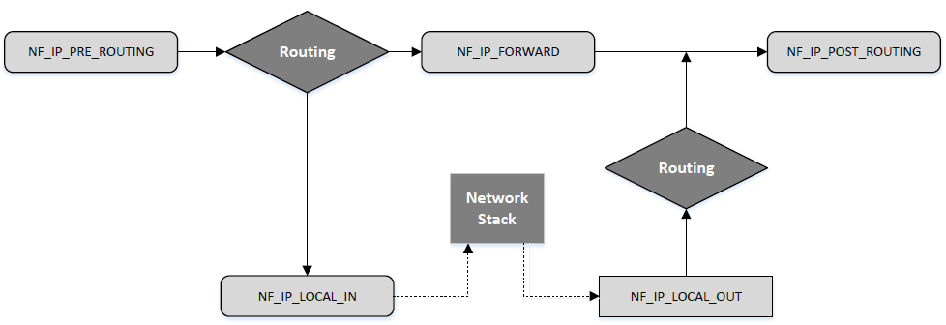
Netfilter Hooks for IPv4
Notes:
NF_IP_LOCAL_OUT: The packets generated by the current host start its way out to Internet from here.
NF_IP_POST_ROUTING: the packets are about to be out of the host and entering a different network.
NF_IP_PRE_ROUTING: All packets will go through this hook
NF_IP_LOCAL_IN: This hook is called when a packet is destined to the machine itself
NF_IP_FORWARD: This hook is called if the packet is destined to other hosts (not the current host).
Routing: This is routing processing, which either lets in the current host or lets it continue the traverse.
Network Stack: This is where the packet goes through the network layer, transport layer and application layer. Here it ends its traverse at application program socket.

Slide 13
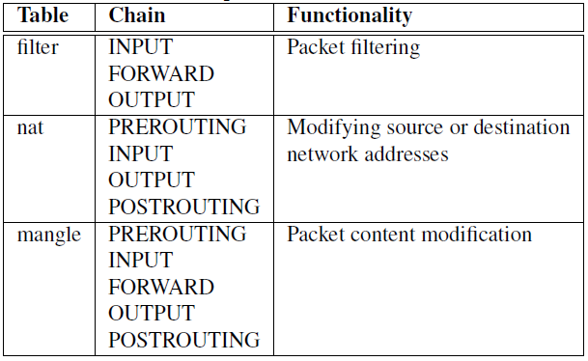
Iptables Firewall in Linux
Iptables is a built-in firewall based on netfilter.
Three tables: filter, nat and mangle
Each table is an independent instance of netfilter. E.g., in filter,
- NF_IP_PRE_ROUTING: do nothing
- NF_IP_LOCAL_IN: using rules in INPUT
- NF_IP_FORWARD: using rules in FORWARD
- NF_IP_LOCAL_OUT: using rules in OUTPUT
All three tables filter, nat and mangle form the firewall of Iptables.
Notes:
PREROUTING: for altering incoming packets before routing;
OUTPUT: for altering locally-generated packets before routing;
INPUT: for packets coming into the box itself,
FORWARD: for altering packets being routed through the box;
POSTROUTING: for altering packets as they are about to go out.

Slide 14
Iptables Firewall - Structure
Each table contains several chains, each of which corresponds to a netfilter hook.
Each chain indicates which hook its rules are enforced at.
Example : Rules on FORWARD chain are enforced at NF_IP_FORWARD hook and rules on INPUT chain are enforced at NF_IP_LOCAL_IN hook.
Each chain contains a set of firewall rules that will be enforced.
User can add rules to the chains.
Example : To block all incoming telnet traffic, add a rule to the INPUT chain of the filter table

Slide 15
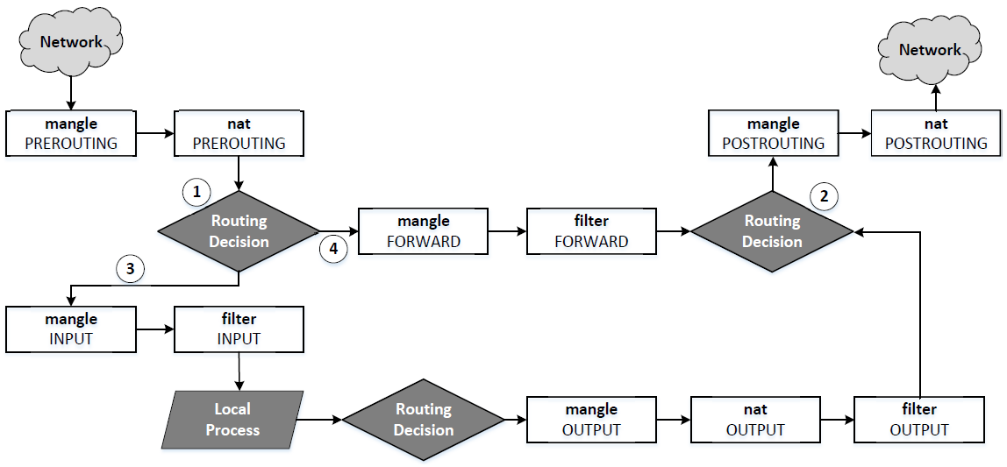
Netfilter structure: merging Filter, NAT and Mangle
Notes:
In the figure, option 1, 2, 3, 4 are explained as follows.
Do the routing decision: the current packet is going to the current host or going to other hosts.
Decide which interface to send out the packet.
Take the packet in as destined to the current host
Let the packet continue traverse to other hosts.
Since filter, NAT and mangles are independents firewall, they all go through Netfilter basic structure. It turns out, a Netfilter hook could be processed by more than one times.
For example, NF_IP_PRE_ROUTING hook is implemented by mangle and nat both. However, the processings by NAT and MANGLE are certainly different.

Slide 16
Rule Matching at a chain
As a packet traverses through each chain, rules on the chain are examined to see whether there is a match or not. If there is a match, the corresponding target action is executed: ACCEPT, DROP, REJECT, or jump to user-defined chain.

Slide 17
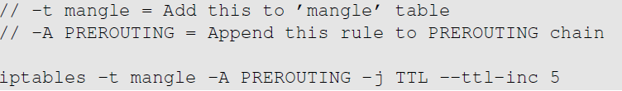
Rule Matching at a chain: example
Example: Increase the TTL field of all packets by 5.
Solution: Add a rule to the mangle table and choose a chain provided by netfilter hooks. We choose PREROUTING chain so the changes can be applied to all packets, regardless they are for the current host or for others.
Notes:
-j: it executes the target rule TTL –ttl-inc 5, which will increase TTL field of a packet by 5.
In general, this will have format:
-j target target-opt, where target is the program (or module) name and tart-opt is its option.
The possible target modules are described in man iptables-extensions. You can see in the description that TTL module is only available for mangle table.
Also, target can be ACCEPT, DROP or RETURN. Here ACCEPT means to let the packet through. DROP means to drop the packet on the floor. RETURN means stop traversing this chain and resume at the next rule in the previous (calling) chain.

Slide 18
Iptables Extension (example): owner module
Iptables functions can be extended using modules also called as extensions.
Owner: To specify rules based on user ids.
format: -m owner --uid-owner seed
Application: How to prevent user Alice from sending out telnet packets?
Analysis: Owner module can match packets based on the user/group id of the process that created them. This works only for OUTPUT chain (outgoing packets) as it is impossible to find the user ids for INPUT chain (incoming packets).

Slide 19
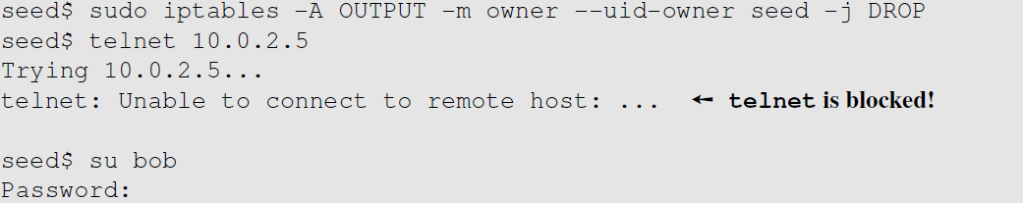
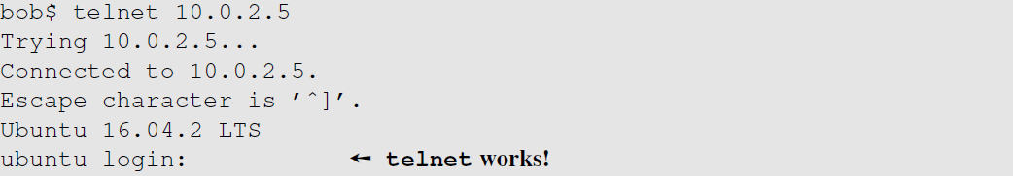
Iptables Extension: Block a Specific User
This rule drops the packets generated by any program owned by user seed. Other users are not affected.

Slide 20
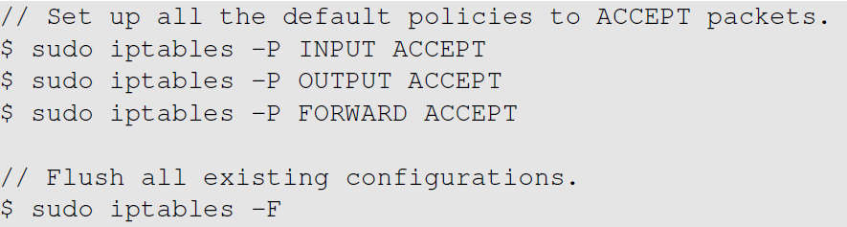
Building a Simple Firewall
Flush all existing firewall configurations
Default policy is set to ACCEPT before all the rules.
All commands here omit the default table: -t filter
So actually, the above flush should be sudo iptables –t filter -F
Notes:
-P define the default policy. The general format is
-P chain_name ACCEPT_or_DROP
-t TABLE_NAME is ignored in the above slides. Then, it applies to the default table filter. If we want to apply this default policy to other tables, you need to specify the table name: e.g., -t nat

Slide 21
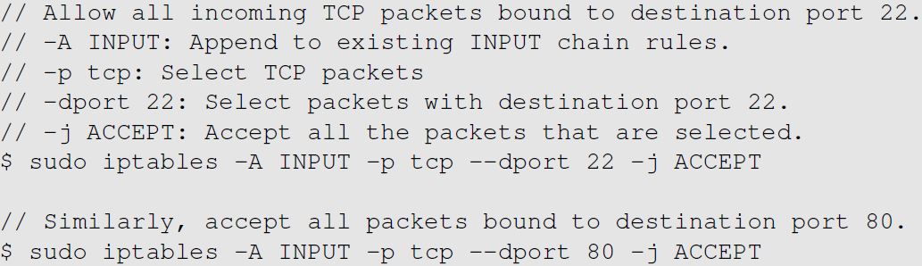
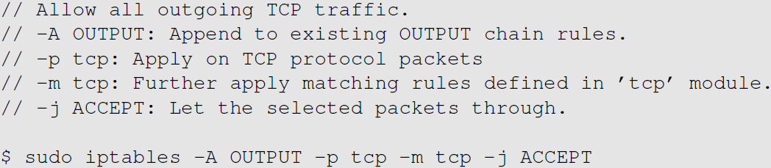
Building a Simple Firewall
Rule on INPUT chain to allow TCP traffic to ports 22 and 80
-p stands for protocol
j for jump to tartget. Here the tartget is ACCEPT
In iptables-extensions
Rule on OUTPUT chain to allow all outgoing TCP traffic
-m tcp can be omitted
Notes:
-p protocol option. Ex. –p tcp --sport 23; see iptables-extensions for description.
The above rule can be read as
Append a rule to input chain (of default table filter). This rule is: for protocol tcp with dport 22, apply the target decision accept.

Slide 22
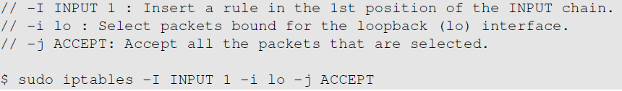

Building a Simple Firewall
-i: for interface
Allow the use of the loopback interface.
Allow DNS queries and replies to pass through.

Slide 23
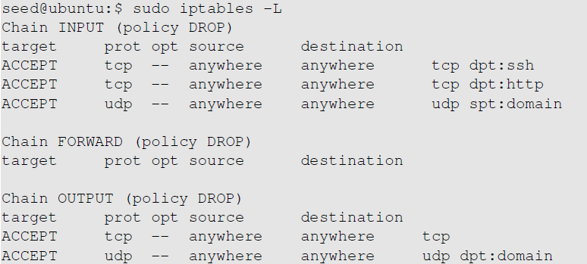
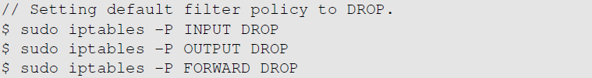
Building a Simple Firewall
These are all the rules we have added
Change the default policy to DROP so that only our configurations on firewall work.

Slide 24
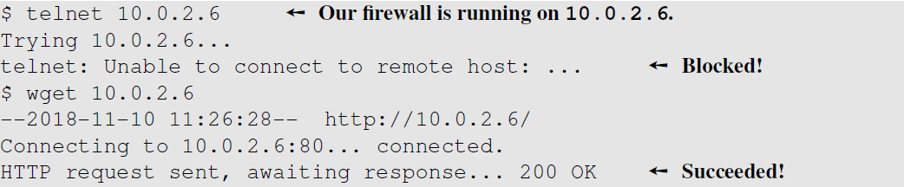
Building a Simple Firewall: Testing
To test our firewall, make connection attempts from a different machine.
Firewall drops all packets except the ones on ports 80(http) and 22(ssh).
Telnet connection made on port 23 failed to connect, but wget connection on port 80 succeeded.
Notes:
After the experiment, remove all the rules by allowing traffic on all the chains and flushing out the existing configurations

Slide 25
Stateful Firewall using Connection Tracking
A stateful firewall monitors incoming and outgoing packets over a period of time.
Records attributes like IP address, port numbers, sequence numbers. Collectively known as connection states.
A connection state, in context of a firewall signifies whether a given packet is a part of an existing flow or not.
Hence, it is applied to both connection-oriented (TCP) and connectionless protocols (UDP and ICMP).

Slide 26
Connection Tracking Framework in Linux
nf_conntrack is a connection tracking framework in Linux kernel built on the top of netfilter.
Each incoming packet is marked with a connection state as described:
NEW: The connection is starting and packet is a part of a valid sequence. It only exists for a connection if the firewall has only seen traffic in one direction.
ESTABLISHED: The connection has been established and is a two-way communication.
RELATED: Special state that helps to establish relationships among different connections. E.g., FTP Control traffic and FTP Data traffic are related.
INVALID : This state is used for packets that do not follow the expected behavior of a connection.
iptables can use nf_conntrack to build stateful firewall rules.

Slide 27
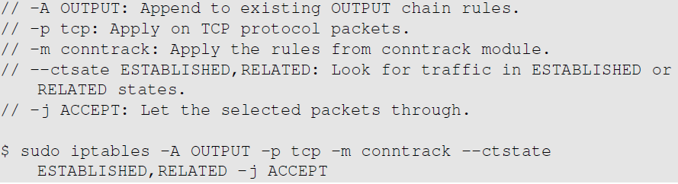
Example: Set up a Stateful Firewall
To set up a firewall rule to only allow outgoing TCP packets if they belong to an established TCP connection.
We only allow ssh and http connection and block all the outgoing TCP traffic if they are not part of an ongoing ssh or http connection.
We will replace the earlier rule with this one based on the connection state.
Notes:
The earlier firewall allowed all the outgoing TCP traffic. An attacker who compromises an internal host can exfiltrate data over TCP. The connection cannot be made as incoming traffic is blocked. But this is sufficient for exfiltrating data. To avoid such attacks, we need to setup stateful firewalls

